Slide 1
Calculus Review
CSC4601 Theory of Machine Learning

Slide 2
Introduction
In the second half of the term, we are going to focus on fitting models
In short, fitting involves:
Defining an objective function
Finding a set of parameters that optimize the output of the objective function
Optimization employs techniques from calculus
We're going to quickly review key concepts from calculus

Slide 3
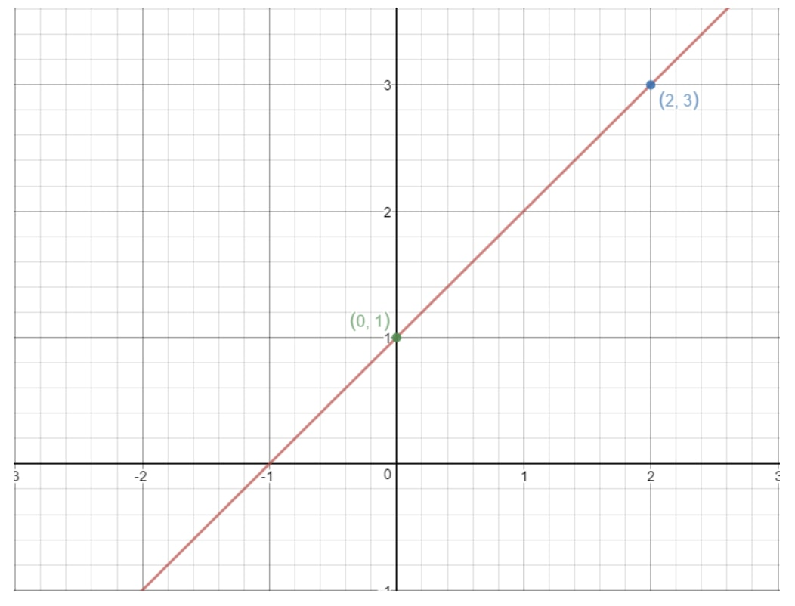

Slope of a Line
$$y=mx+b$$

Slide 4



Slope of a Line
$$y=mx+b$$
$$m=\frac{Δy}{Δx}$$
$$\text{rise}\text{:} Δy$$
$$\text{run}\text{:} Δx$$

Slide 5

Slope of a Line
$$y=mx+b$$
$$m=\frac{Δy}{Δx}$$
$$=\frac{2 −1}{1−0}$$
$$=1$$
$$\text{rise}\text{:} Δy$$
$$\text{run}\text{:} Δx$$

Slide 6



Slope of a Line
$$y=mx+b$$
$$m=\frac{Δy}{Δx}$$
$$=\frac{0 −−1}{−1−−2}$$
$$=1$$
$$\text{rise}\text{:} Δy$$
$$\text{run}\text{:} Δx$$

Slide 7
Slope of a Line
The slope is constant
for all parts of the line
$$\text{rise}\text{:} Δy$$
$$\text{run}\text{:} Δx$$

Slide 8
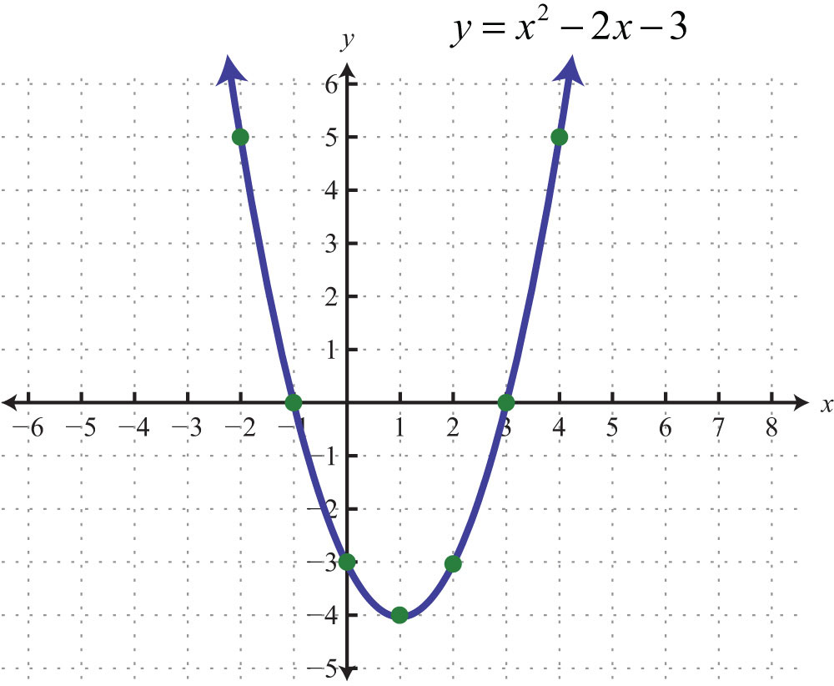



Slope of a Parabola
$$m=\frac{Δy}{Δx}$$
$$=\frac{5 −0}{4−3}$$
$$=5$$
$$\text{rise}\text{:} Δy$$
$$\text{run}\text{:} Δx$$

Slide 9



Slope of a Parabola
$$m=\frac{Δy}{Δx}$$
$$=\frac{5 −0}{−2−−1}$$
$$=−5$$
$$\text{rise}\text{:} Δy$$
$$\text{run}\text{:} Δx$$

Slide 10
Slope of a Parabola
The slope of a parabola
is not constant
It changes for each point
on the curve
$$\text{rise}\text{:} Δy$$
$$\text{run}\text{:} Δx$$

Slide 11
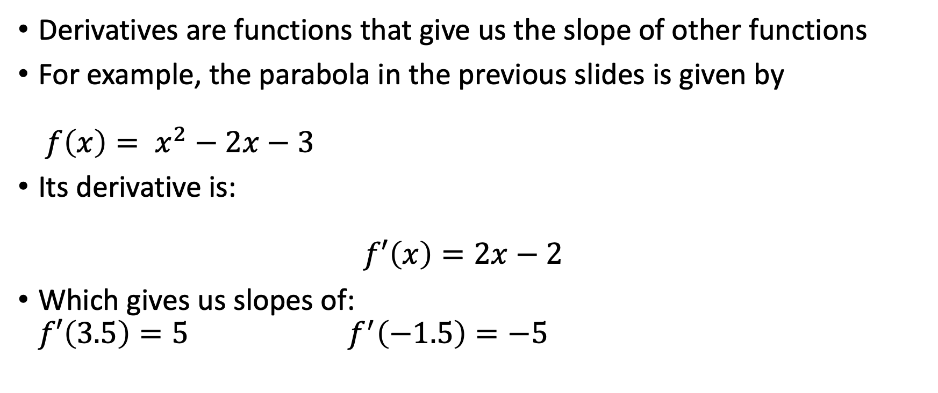
Derivative
Derivatives are functions that give us the slope of other functions
For example, the parabola in the previous slides is given by $f\left(x\right)= x^{2}−2x−3$
Its derivative is: $f′\left(x\right)=2x−2$
Which gives us slopes of: $f′\left(3.5\right)=5$ $f^{′}\left(−1.5\right)=−5$

Slide 12
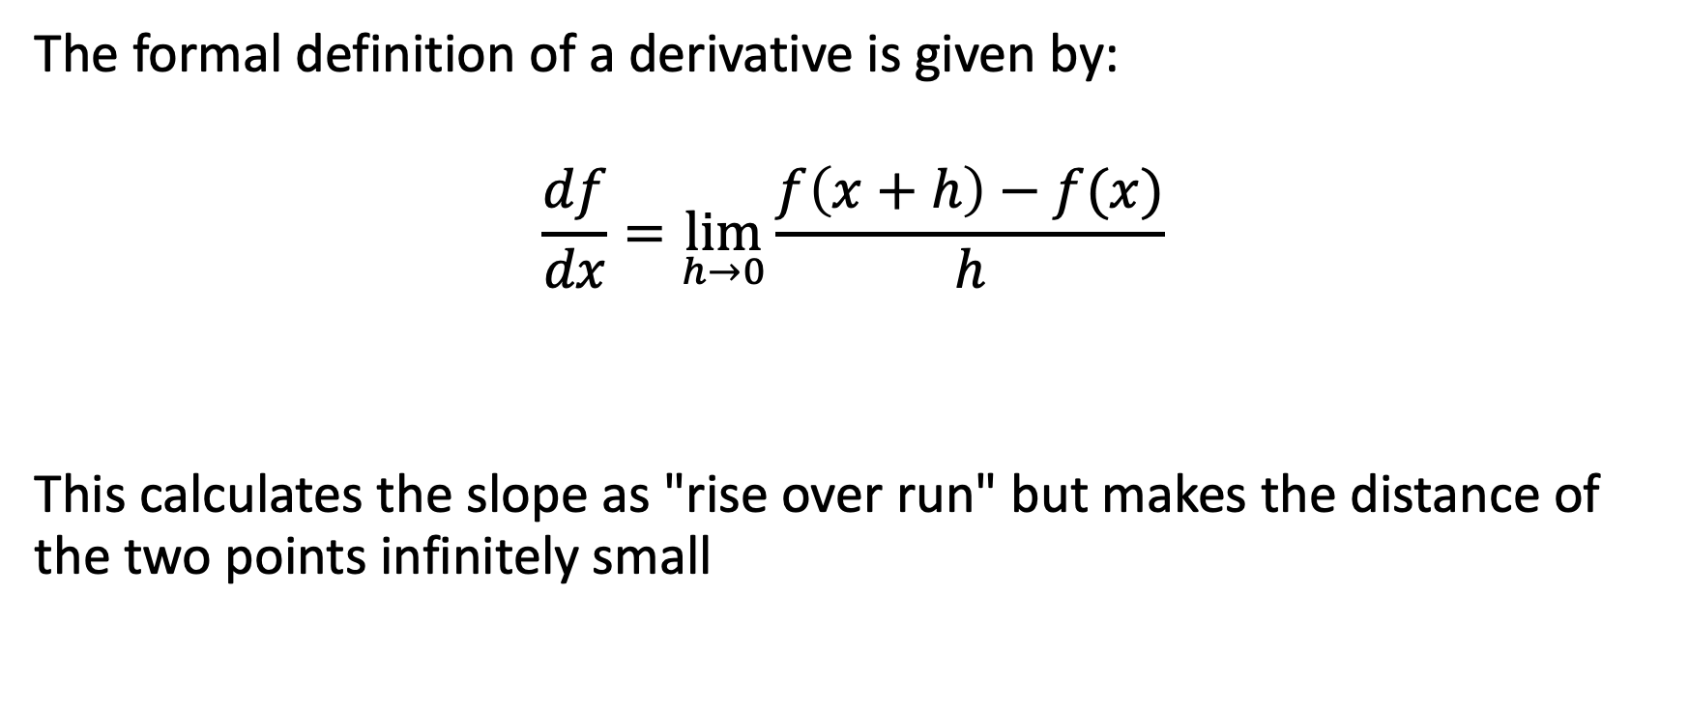
Derivatives
The formal definition of a derivative is given by:
$$\frac{df}{dx}=\lim_{h→0}{\frac{f\left(x+h\right)−f(x)}{h}}$$
This calculates the slope as "rise over run" but makes the distance of the two points infinitely small

Slide 13

Functions with Multiple Variables
We can compute partial derivatives for each input variable of a multiple variable function: $$\frac{∂f}{∂x_{i}}=\lim_{h→0}{\frac{f\left(x_{1}, ⋯,x_{i}+h,⋯,x_{n}\right)−f(x_{1}, ⋯,x_{i},⋯,x_{n})}{h}}$$

Slide 14
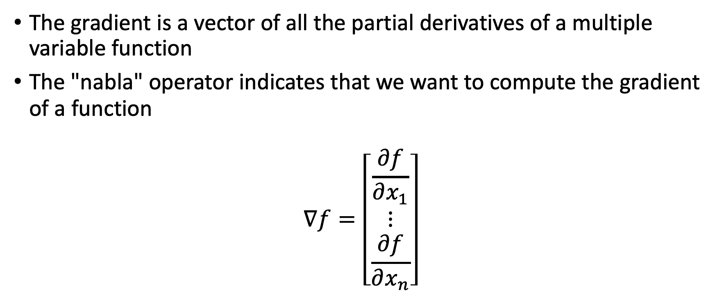
Gradient
The gradient is a vector of all the partial derivatives of a multiple variable function
The "nabla" operator indicates that we want to compute the gradient of a function
$$∇f=\left[\begin{matrix}\frac{∂f}{∂x_{1}} \\ ⋮ \\ \frac{∂f}{∂x_{n}}\end{matrix}\right]$$

Slide 15
Optimization
We want to find a value x* that minimizes or maximizes the output of a function:
f(x*)
Stated more formally,
f(x*) <= f(x) for all x
x* = 1 minimizes
the function

Slide 16
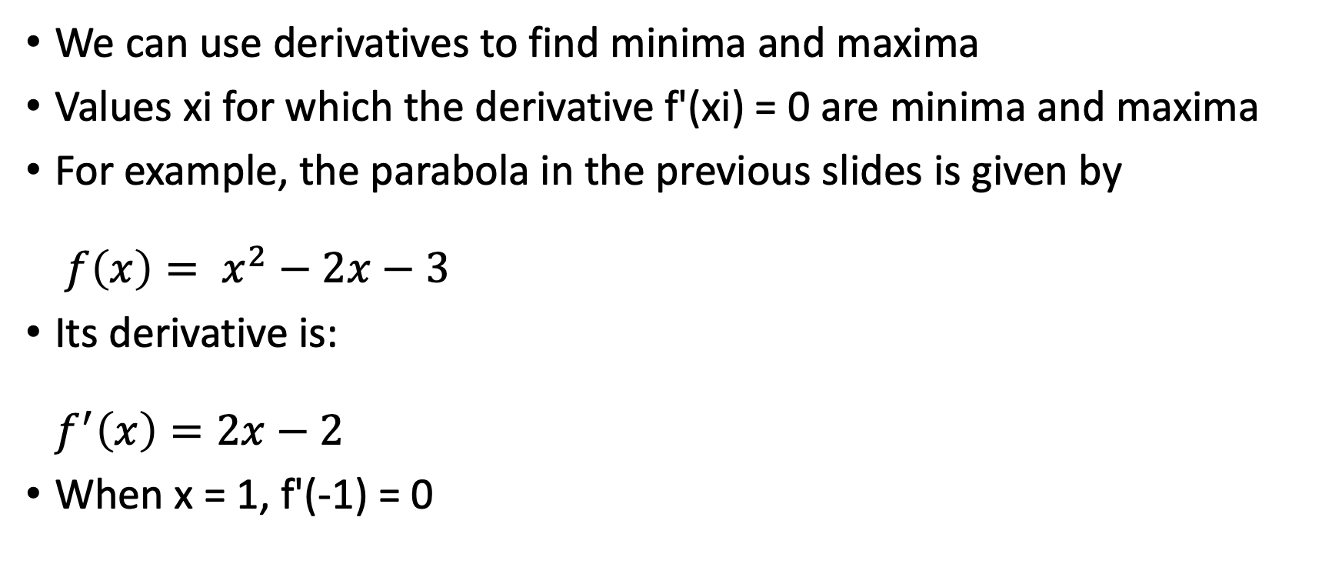
Minimums and Maximums
We can use derivatives to find minima and maxima
Values xi for which the derivative f'(xi) = 0 are minima and maxima
For example, the parabola in the previous slides is given by $f\left(x\right)= x^{2}−2x−3$
Its derivative is: $f^{′}\left(x\right)=2x−2$
When x = 1, f'(-1) = 0

Slide 17
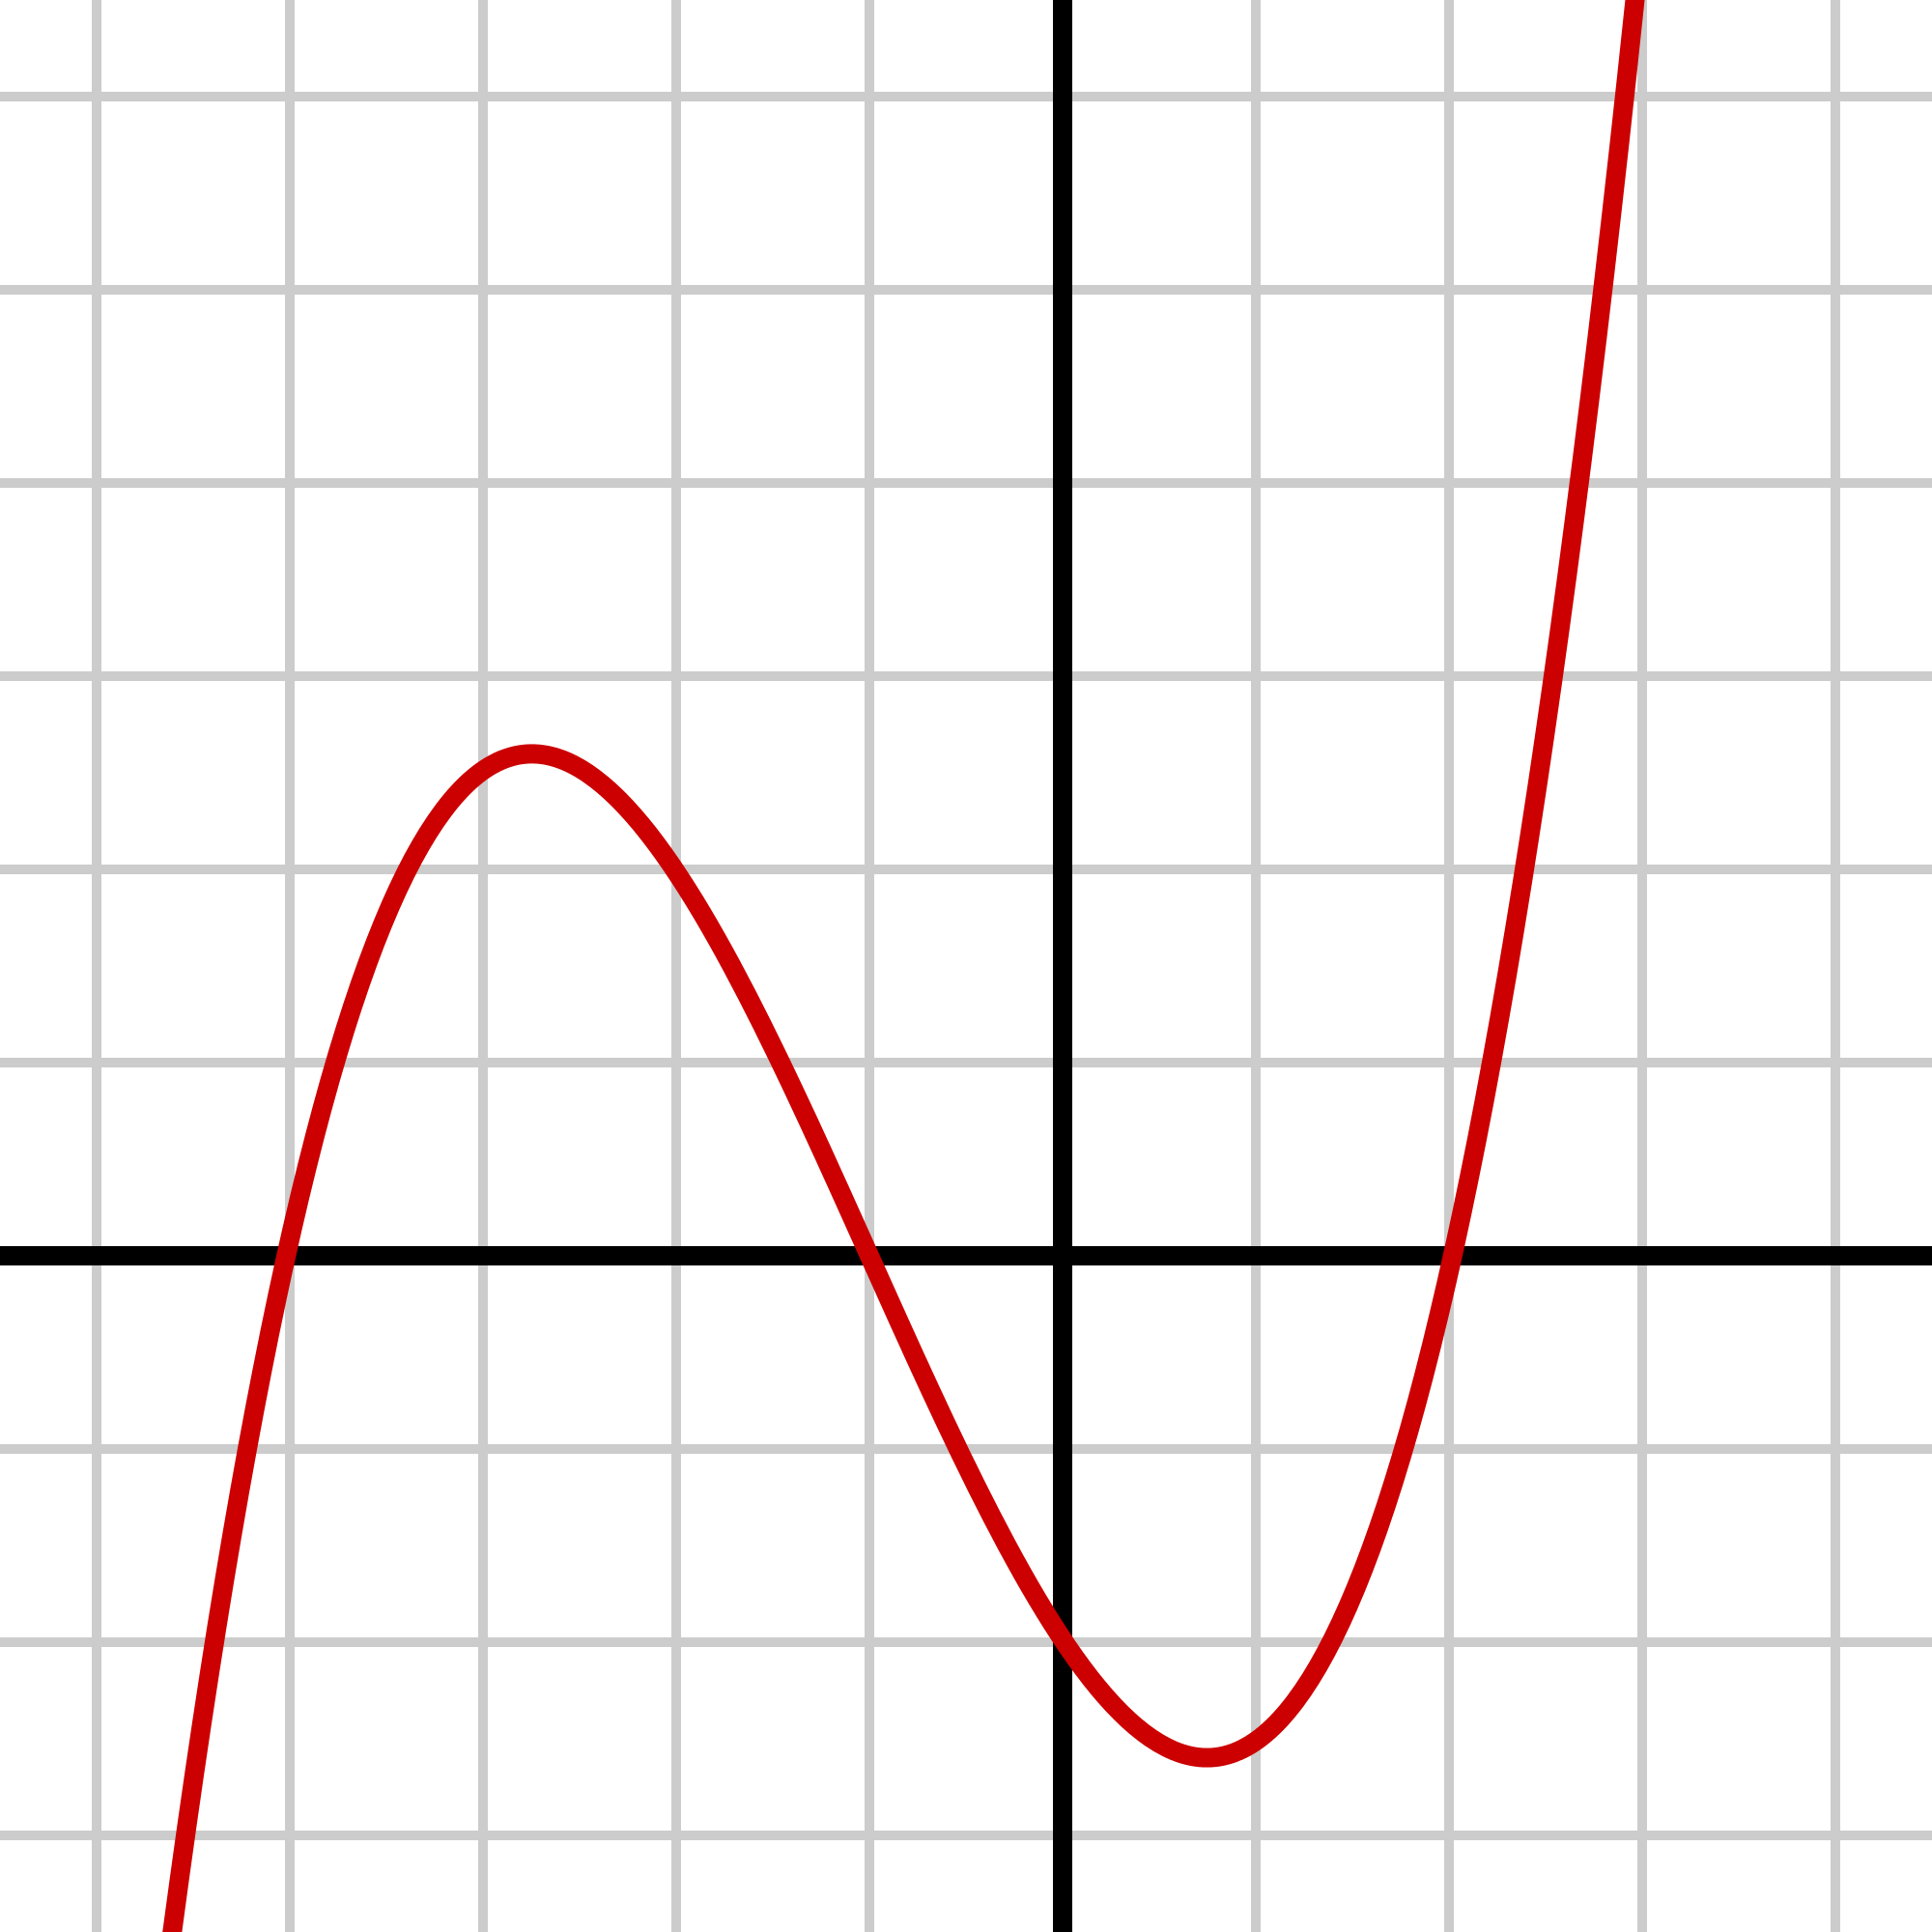
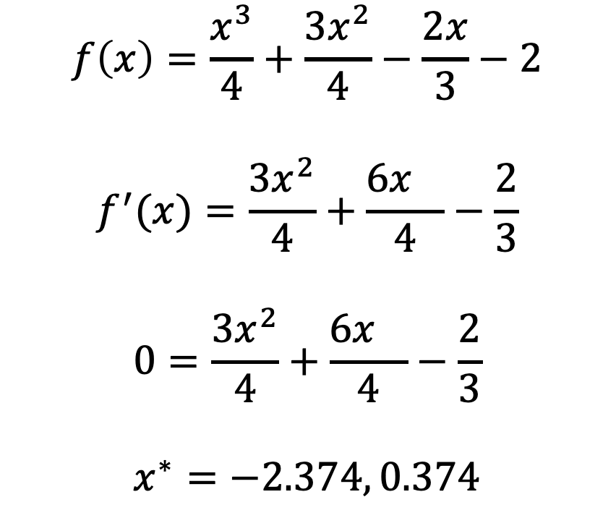
Cubic Example
x* = -2.374
maximizes
the function
$$f\left(x\right)=\frac{x^{3}}{4}+\frac{3x^{2}}{4}−\frac{2x}{3}−2$$
$$f^{′}(x)=\frac{{3x}^{2}}{4}+\frac{6x^{}}{4}−\frac{2}{3}$$
$$0=\frac{{3x}^{2}}{4}+\frac{6x^{}}{4}−\frac{2}{3}$$
$$x^{∗}=−2.374, 0.374$$
x* = 0.374
minimizes
the function

Slide 18
Global vs Local
Local
maximum
Global
maximum
Global
minimum
Local
minimum

Slide 19
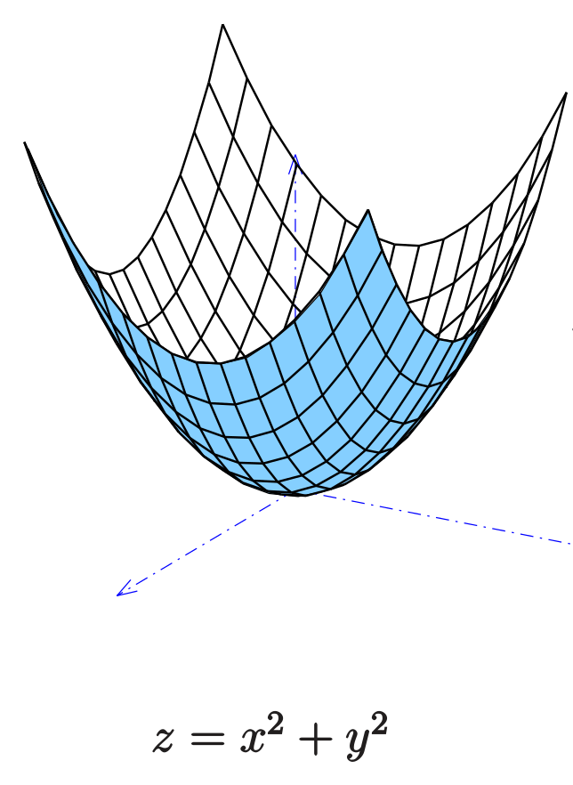
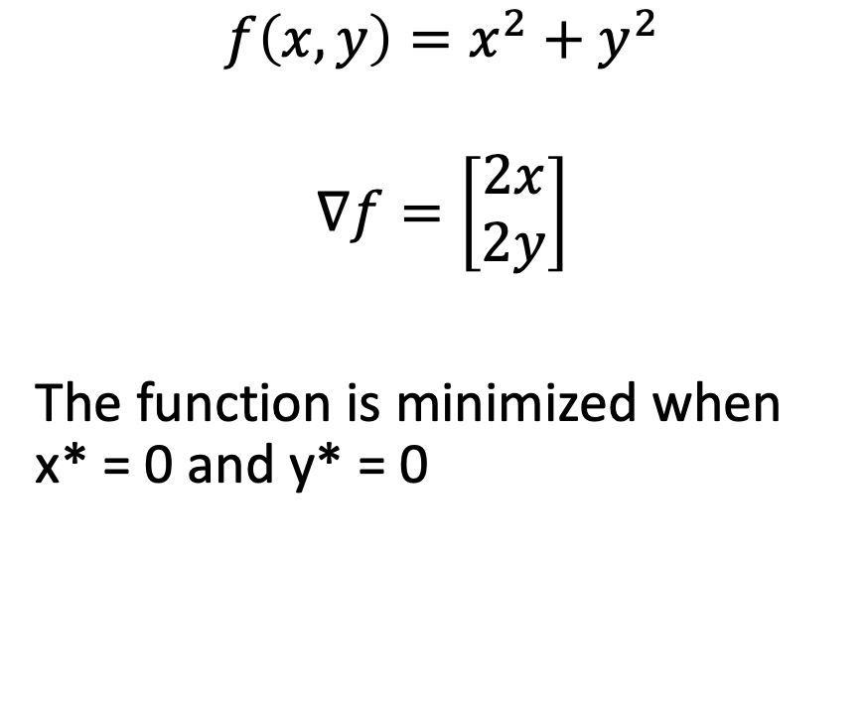
Elliptic Paraboloid Example
$$f\left(x, y\right)=x^{2}+y^{2}$$
$$∇f=\left[\begin{matrix}2x \\ 2y\end{matrix}\right]$$
The function is minimized when x* = 0 and y* = 0

